Slide 1

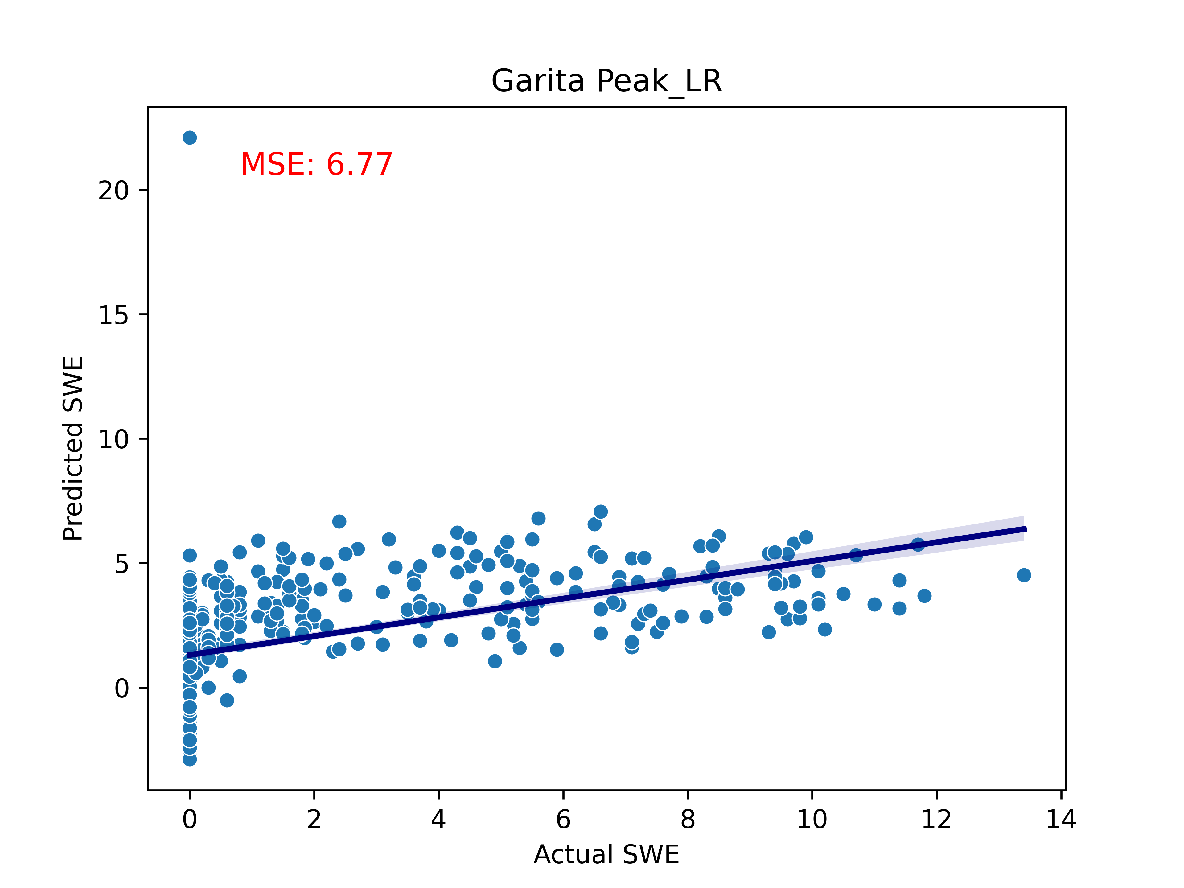
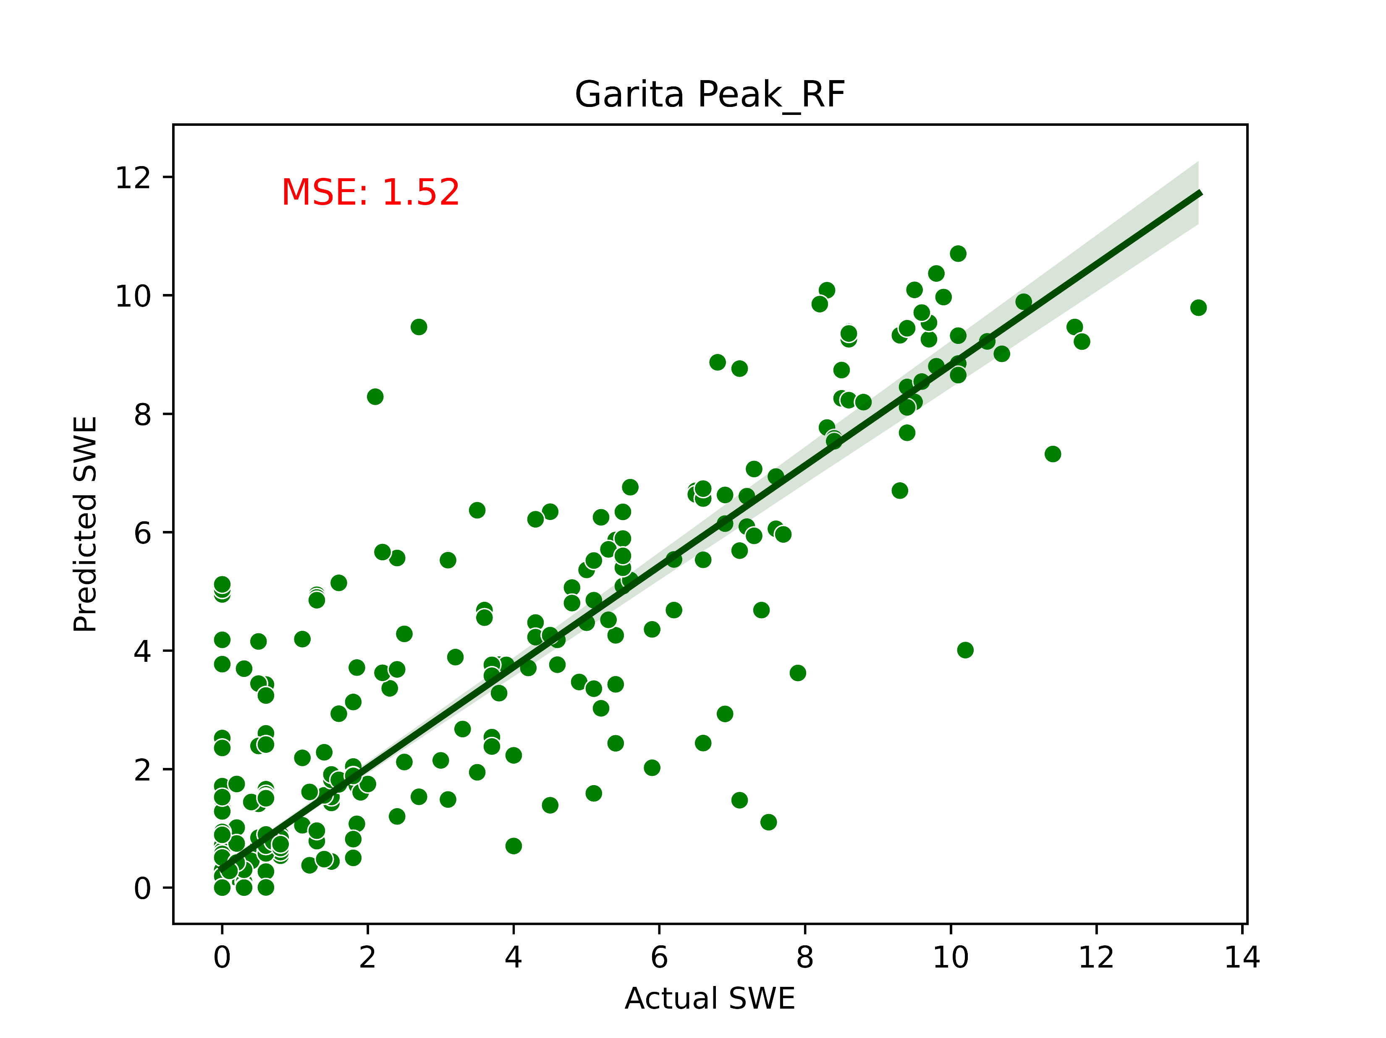
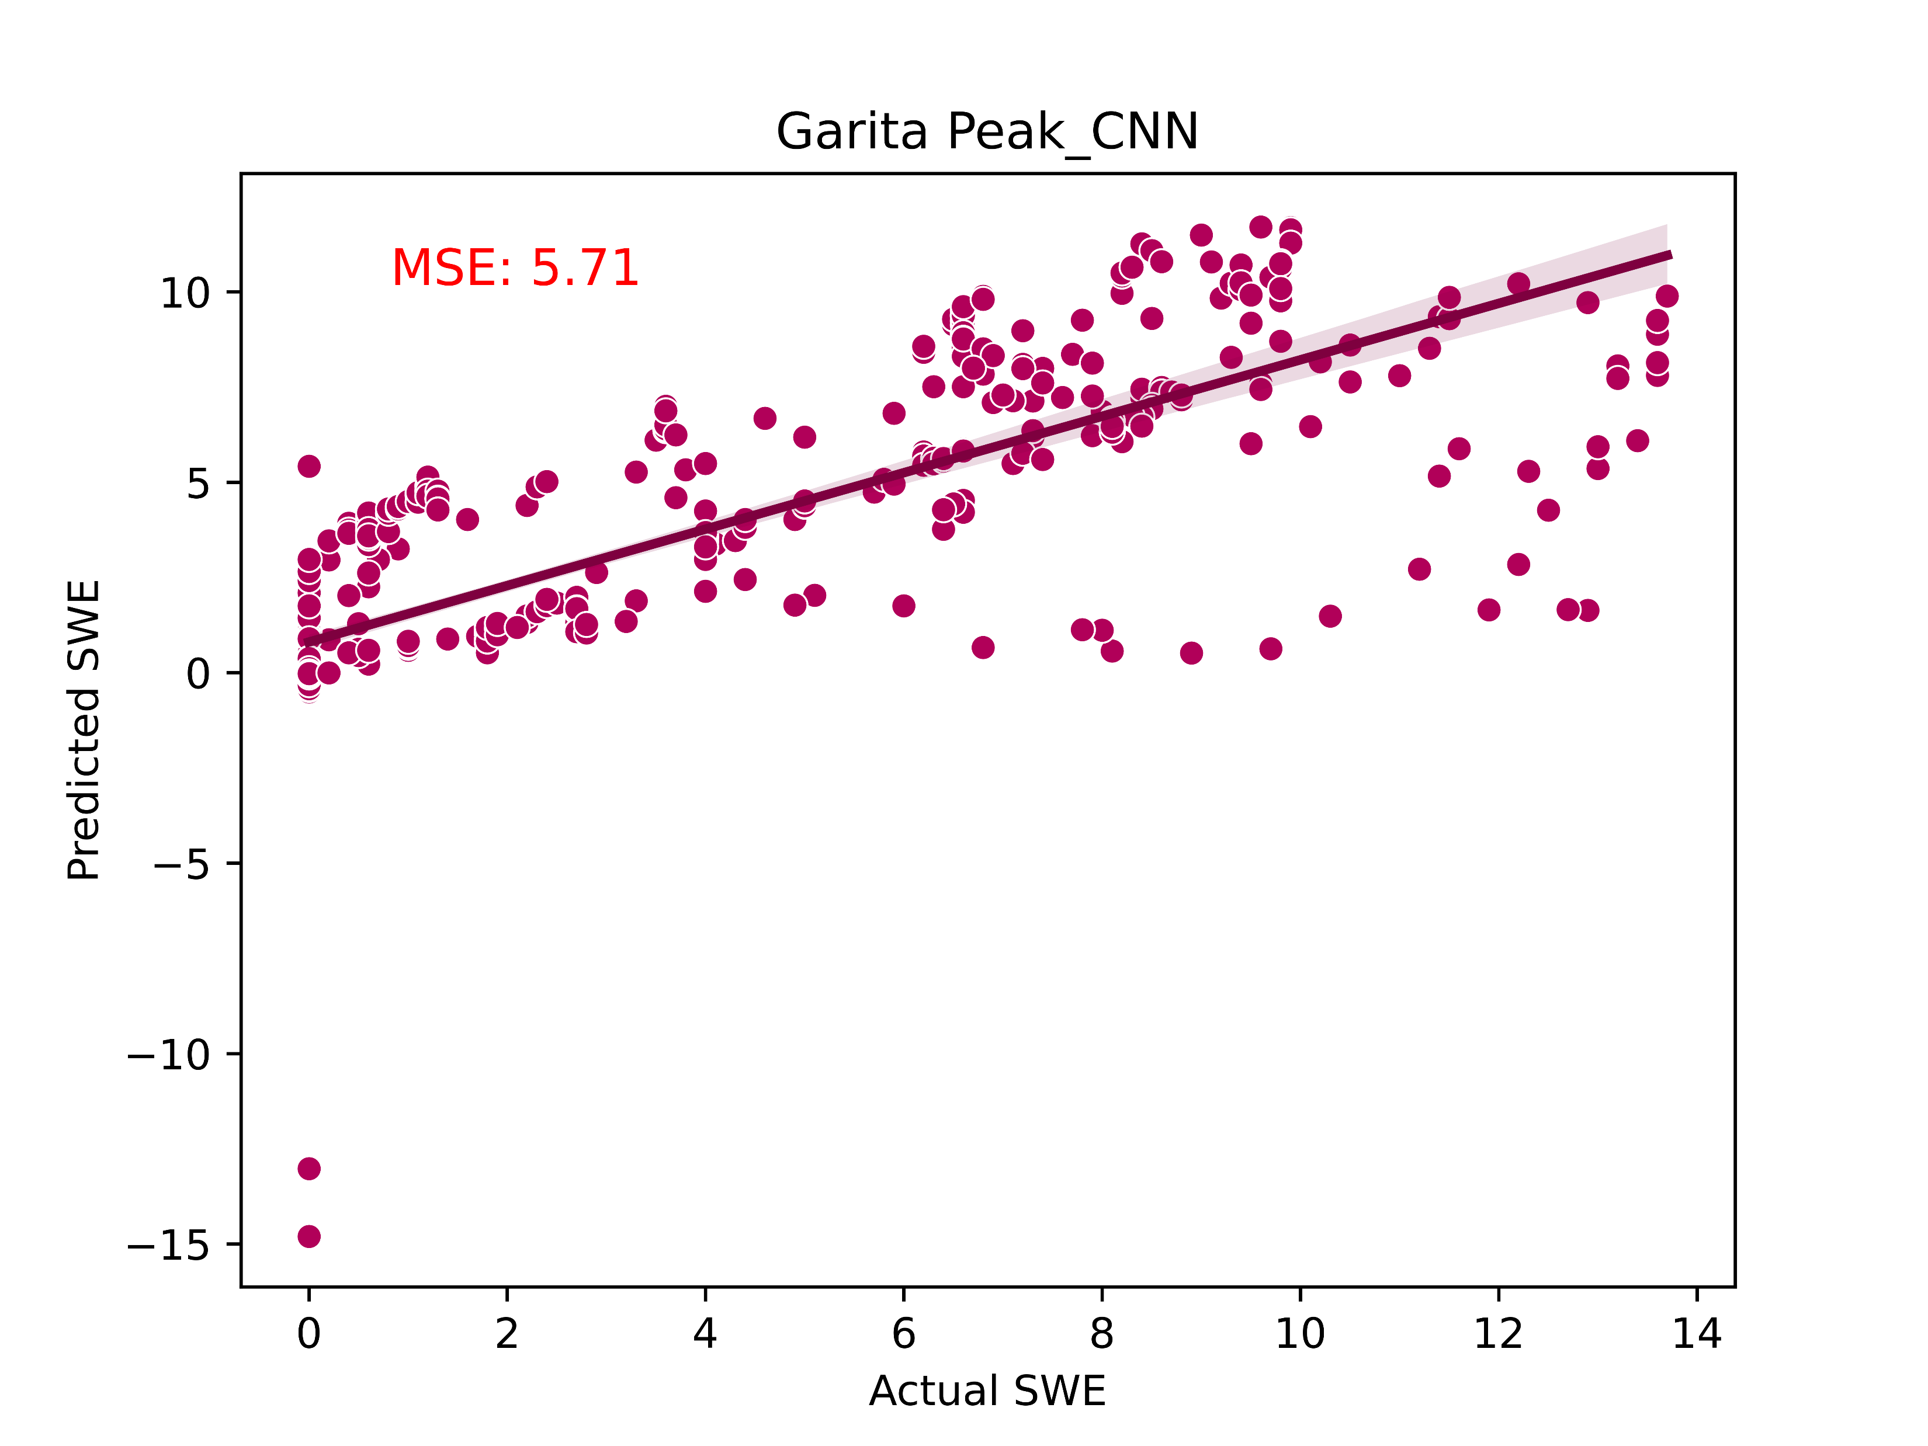
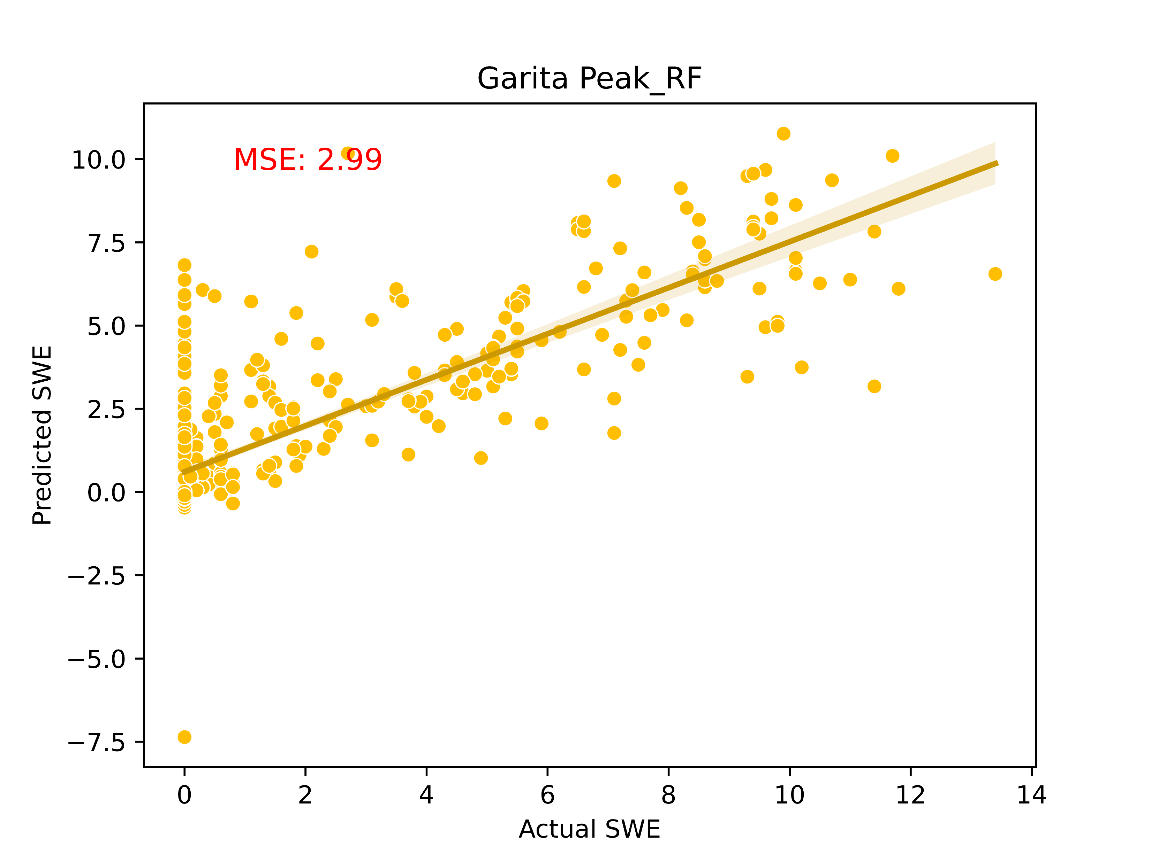
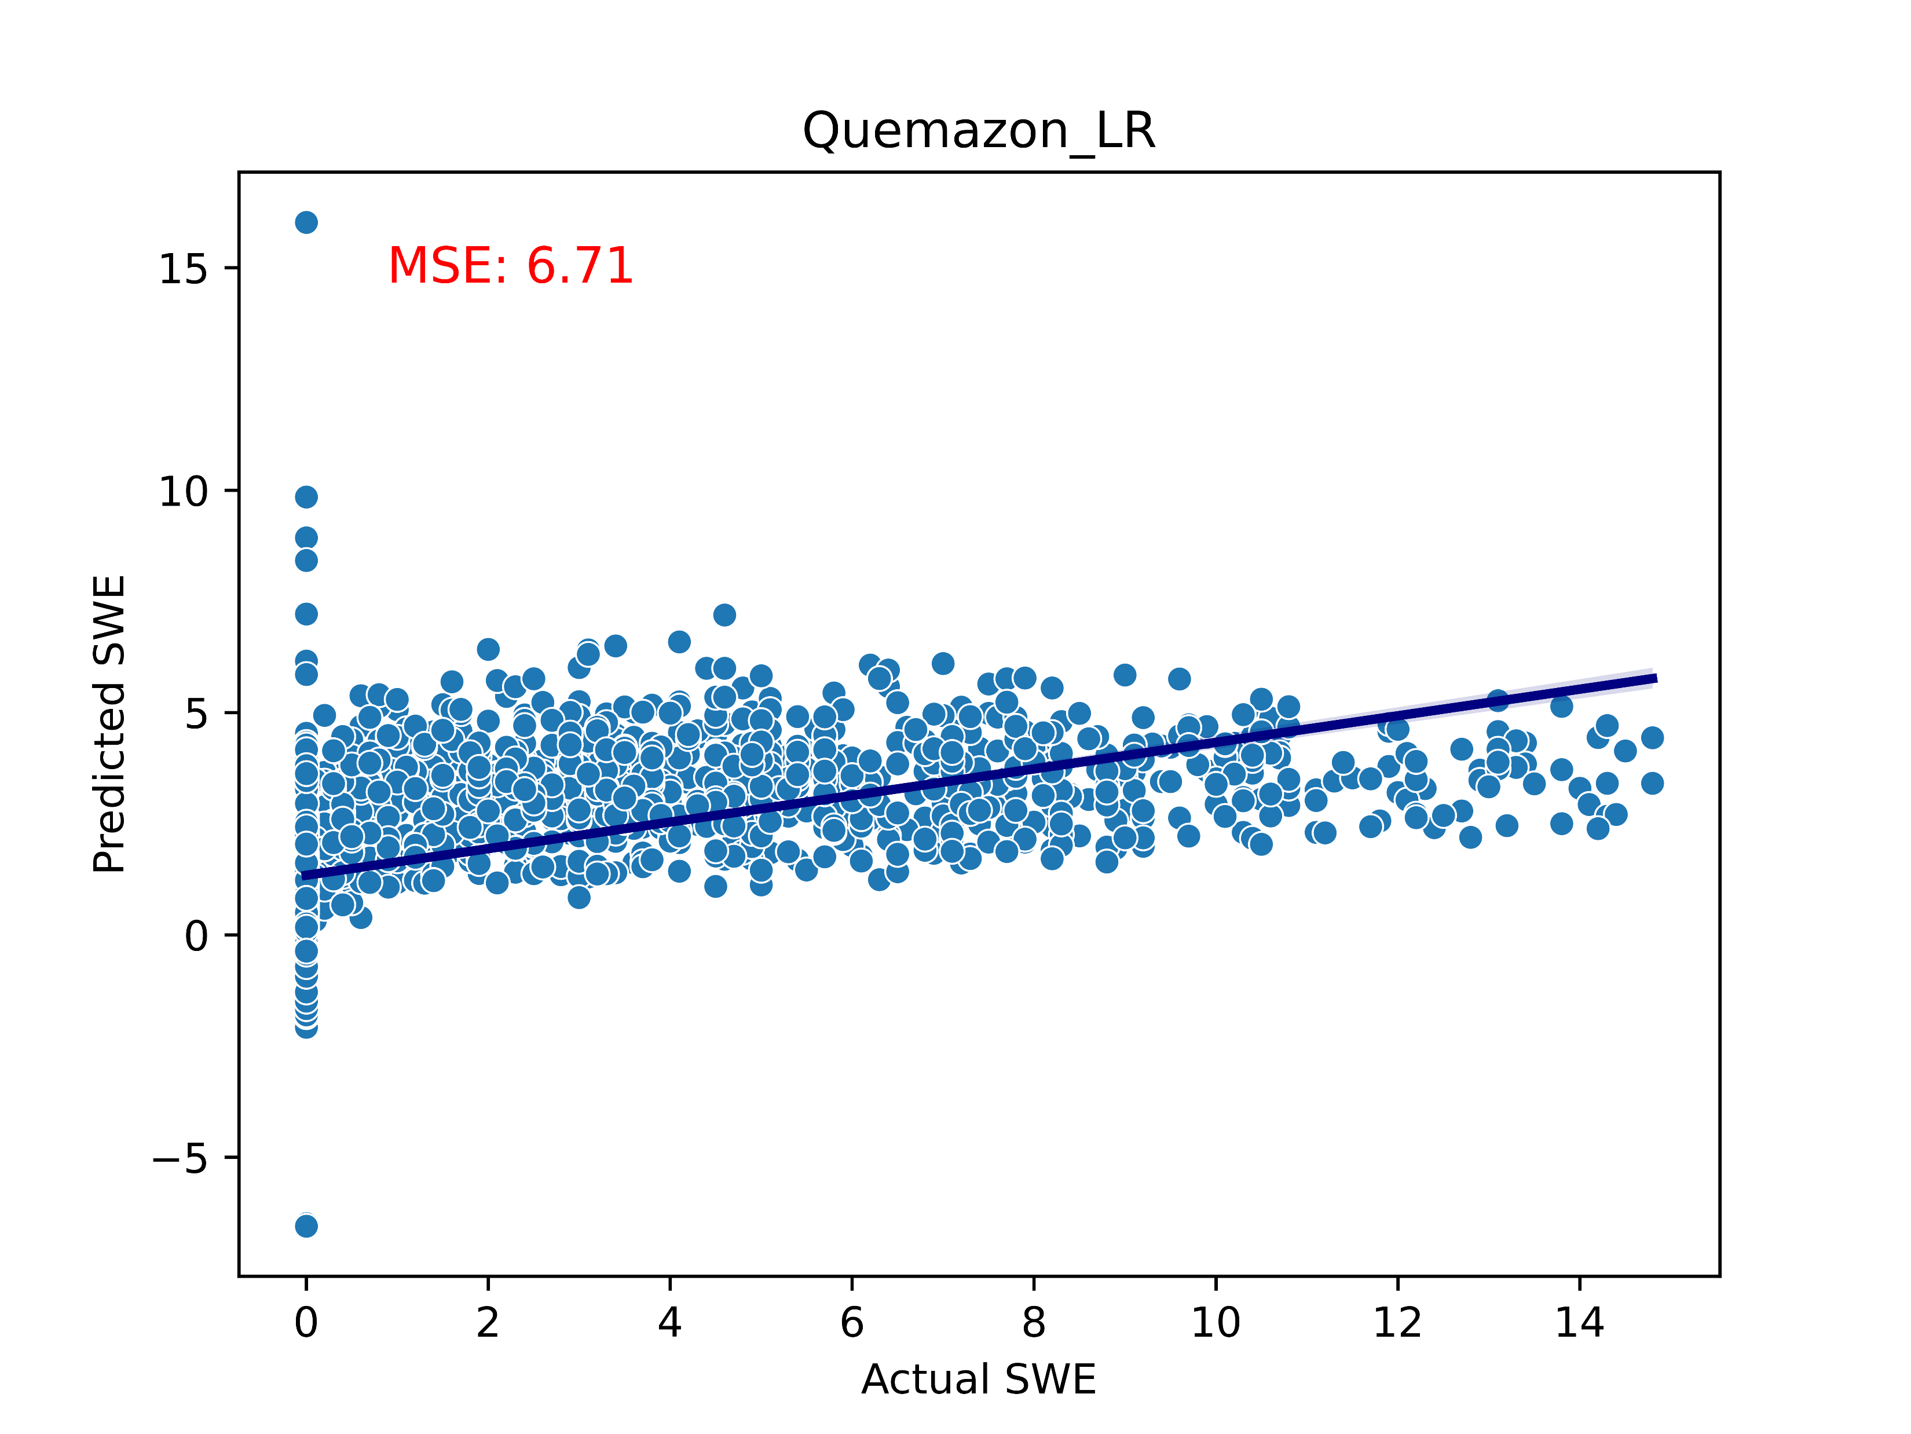
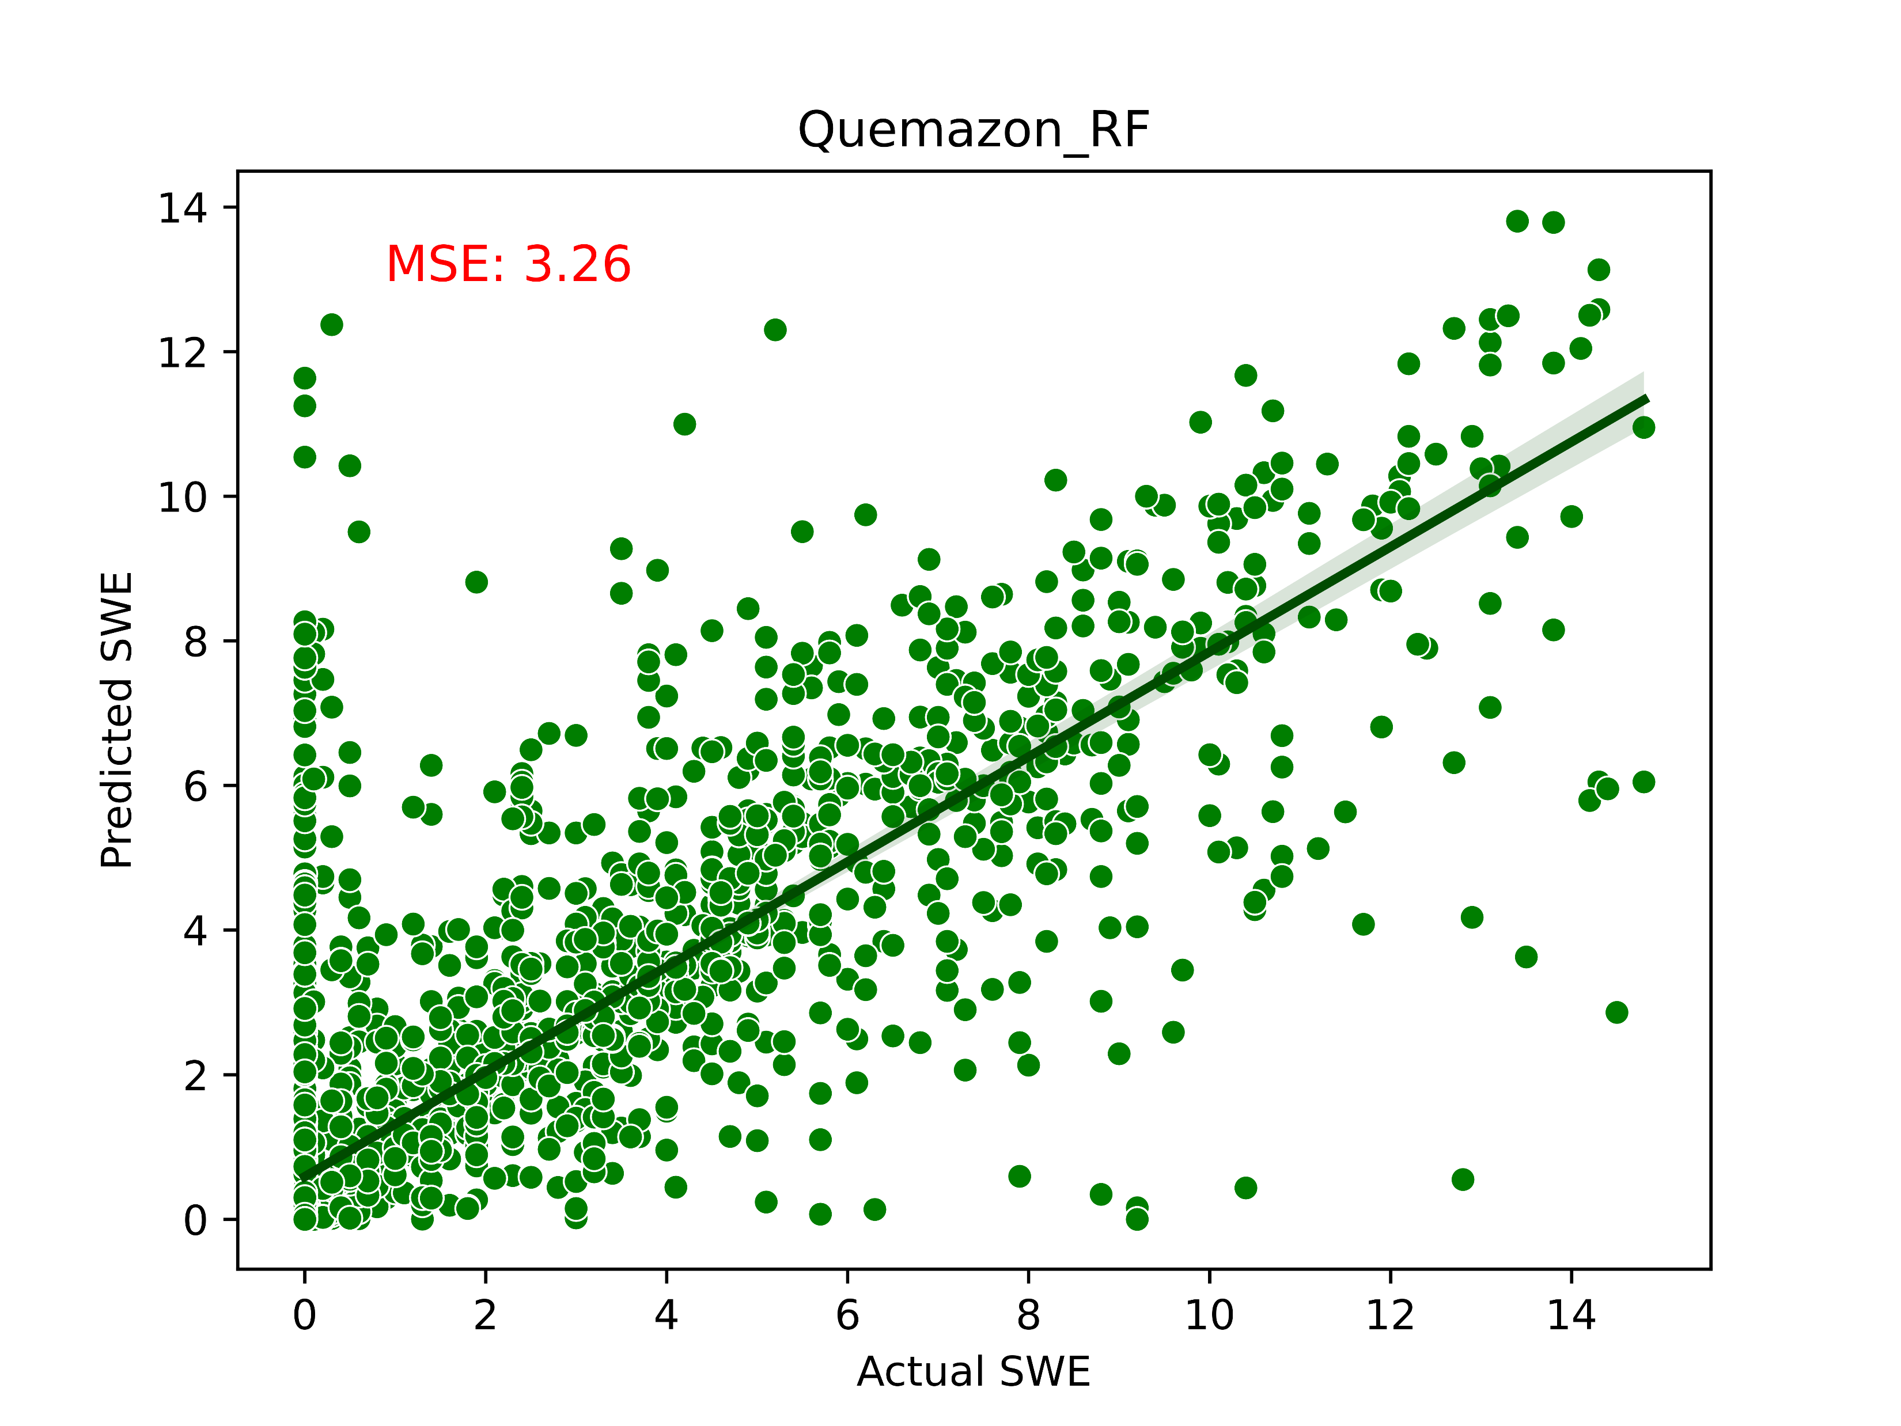
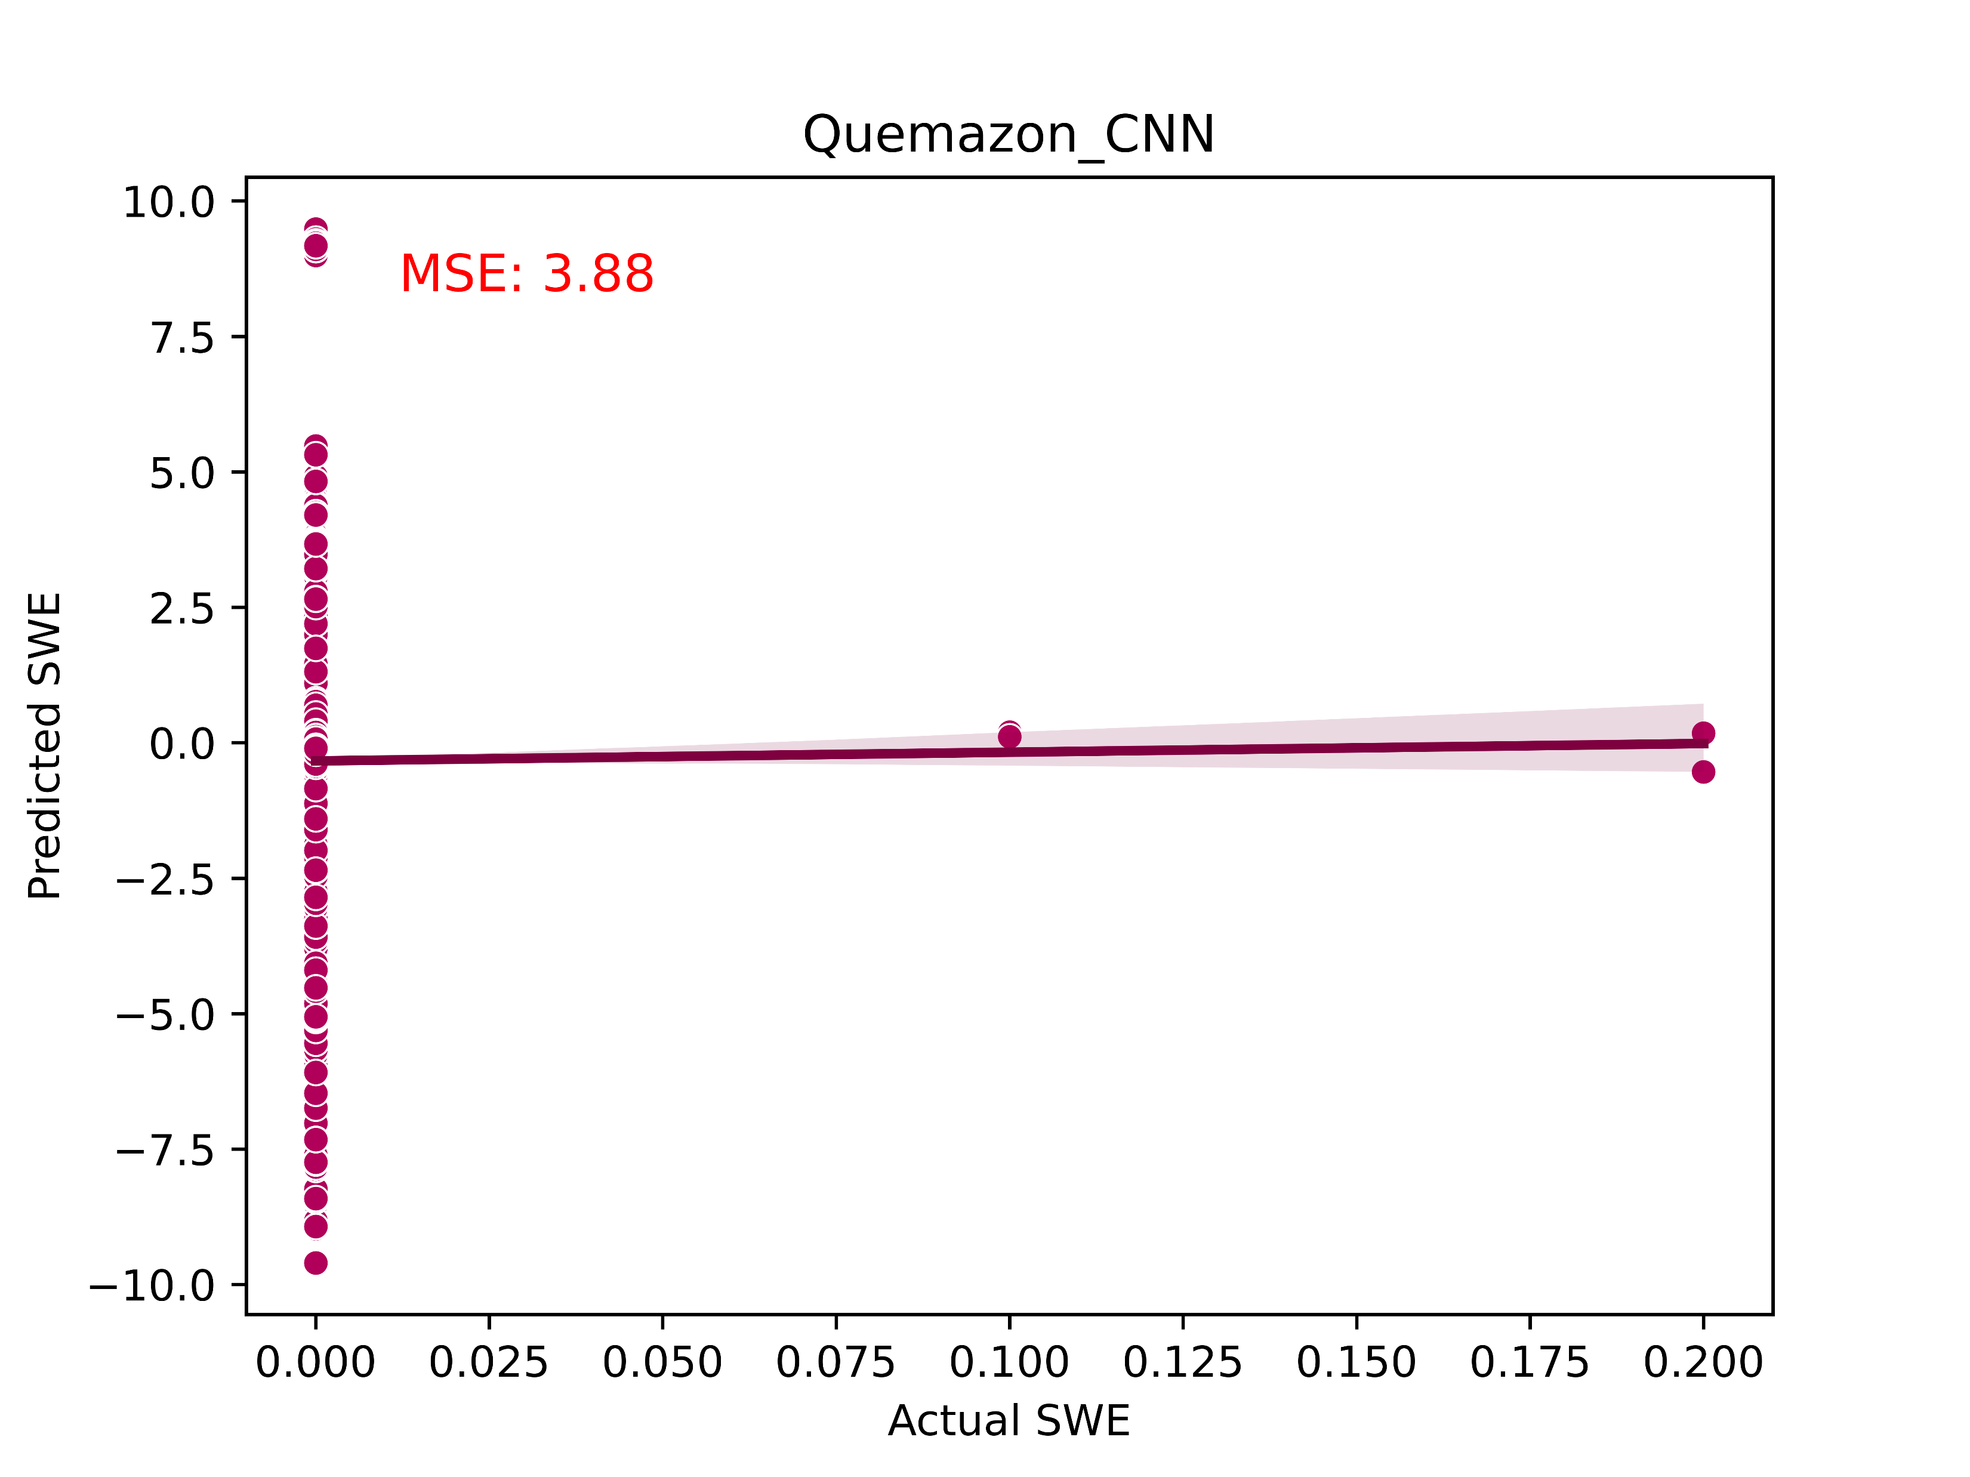
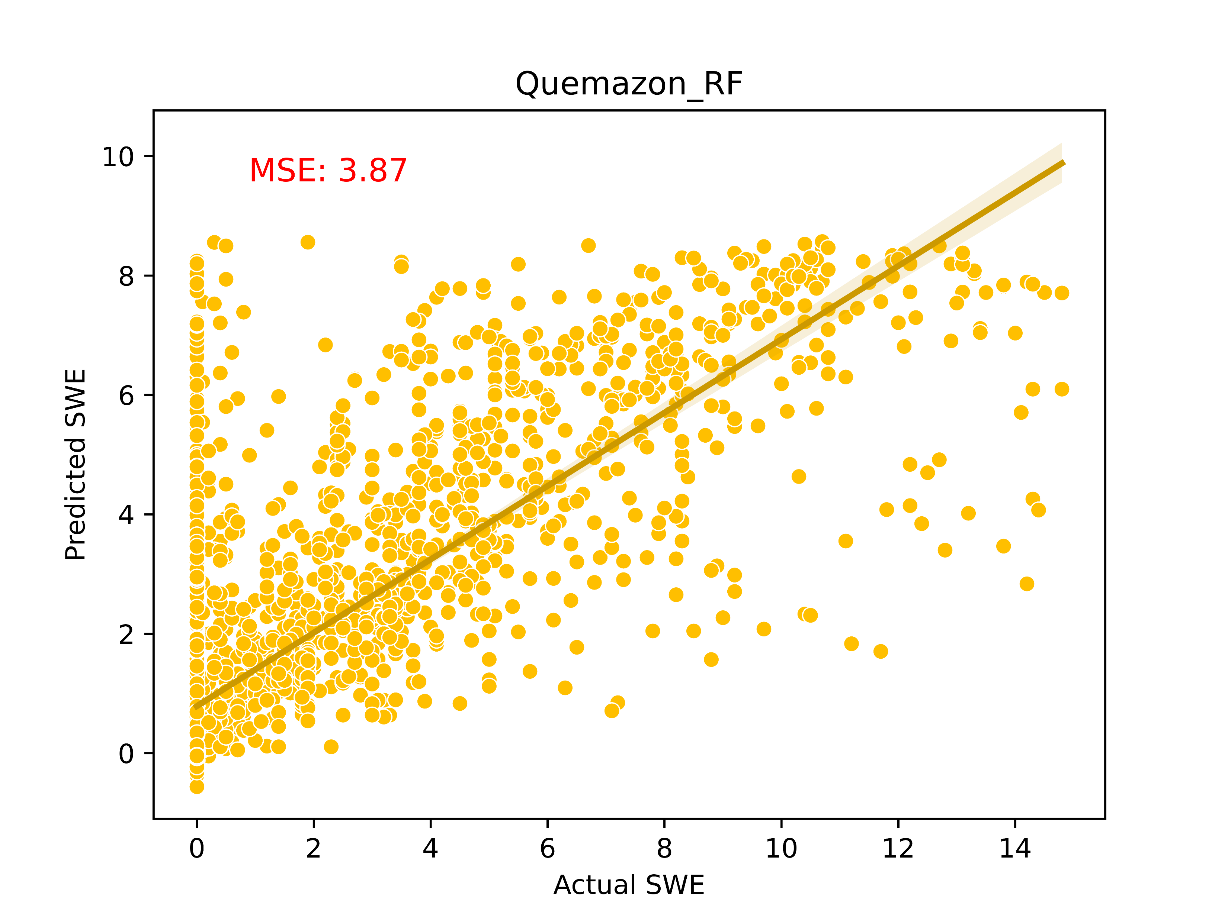
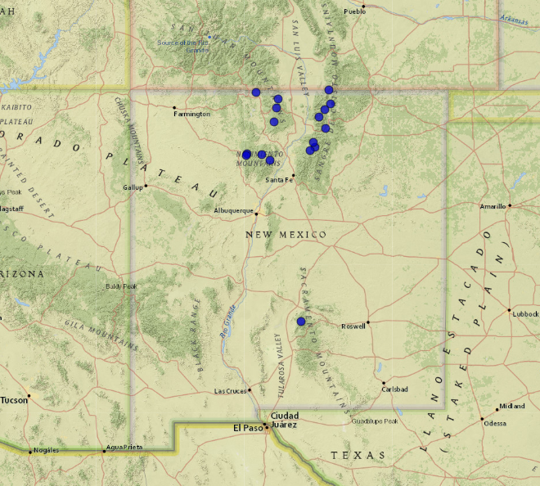
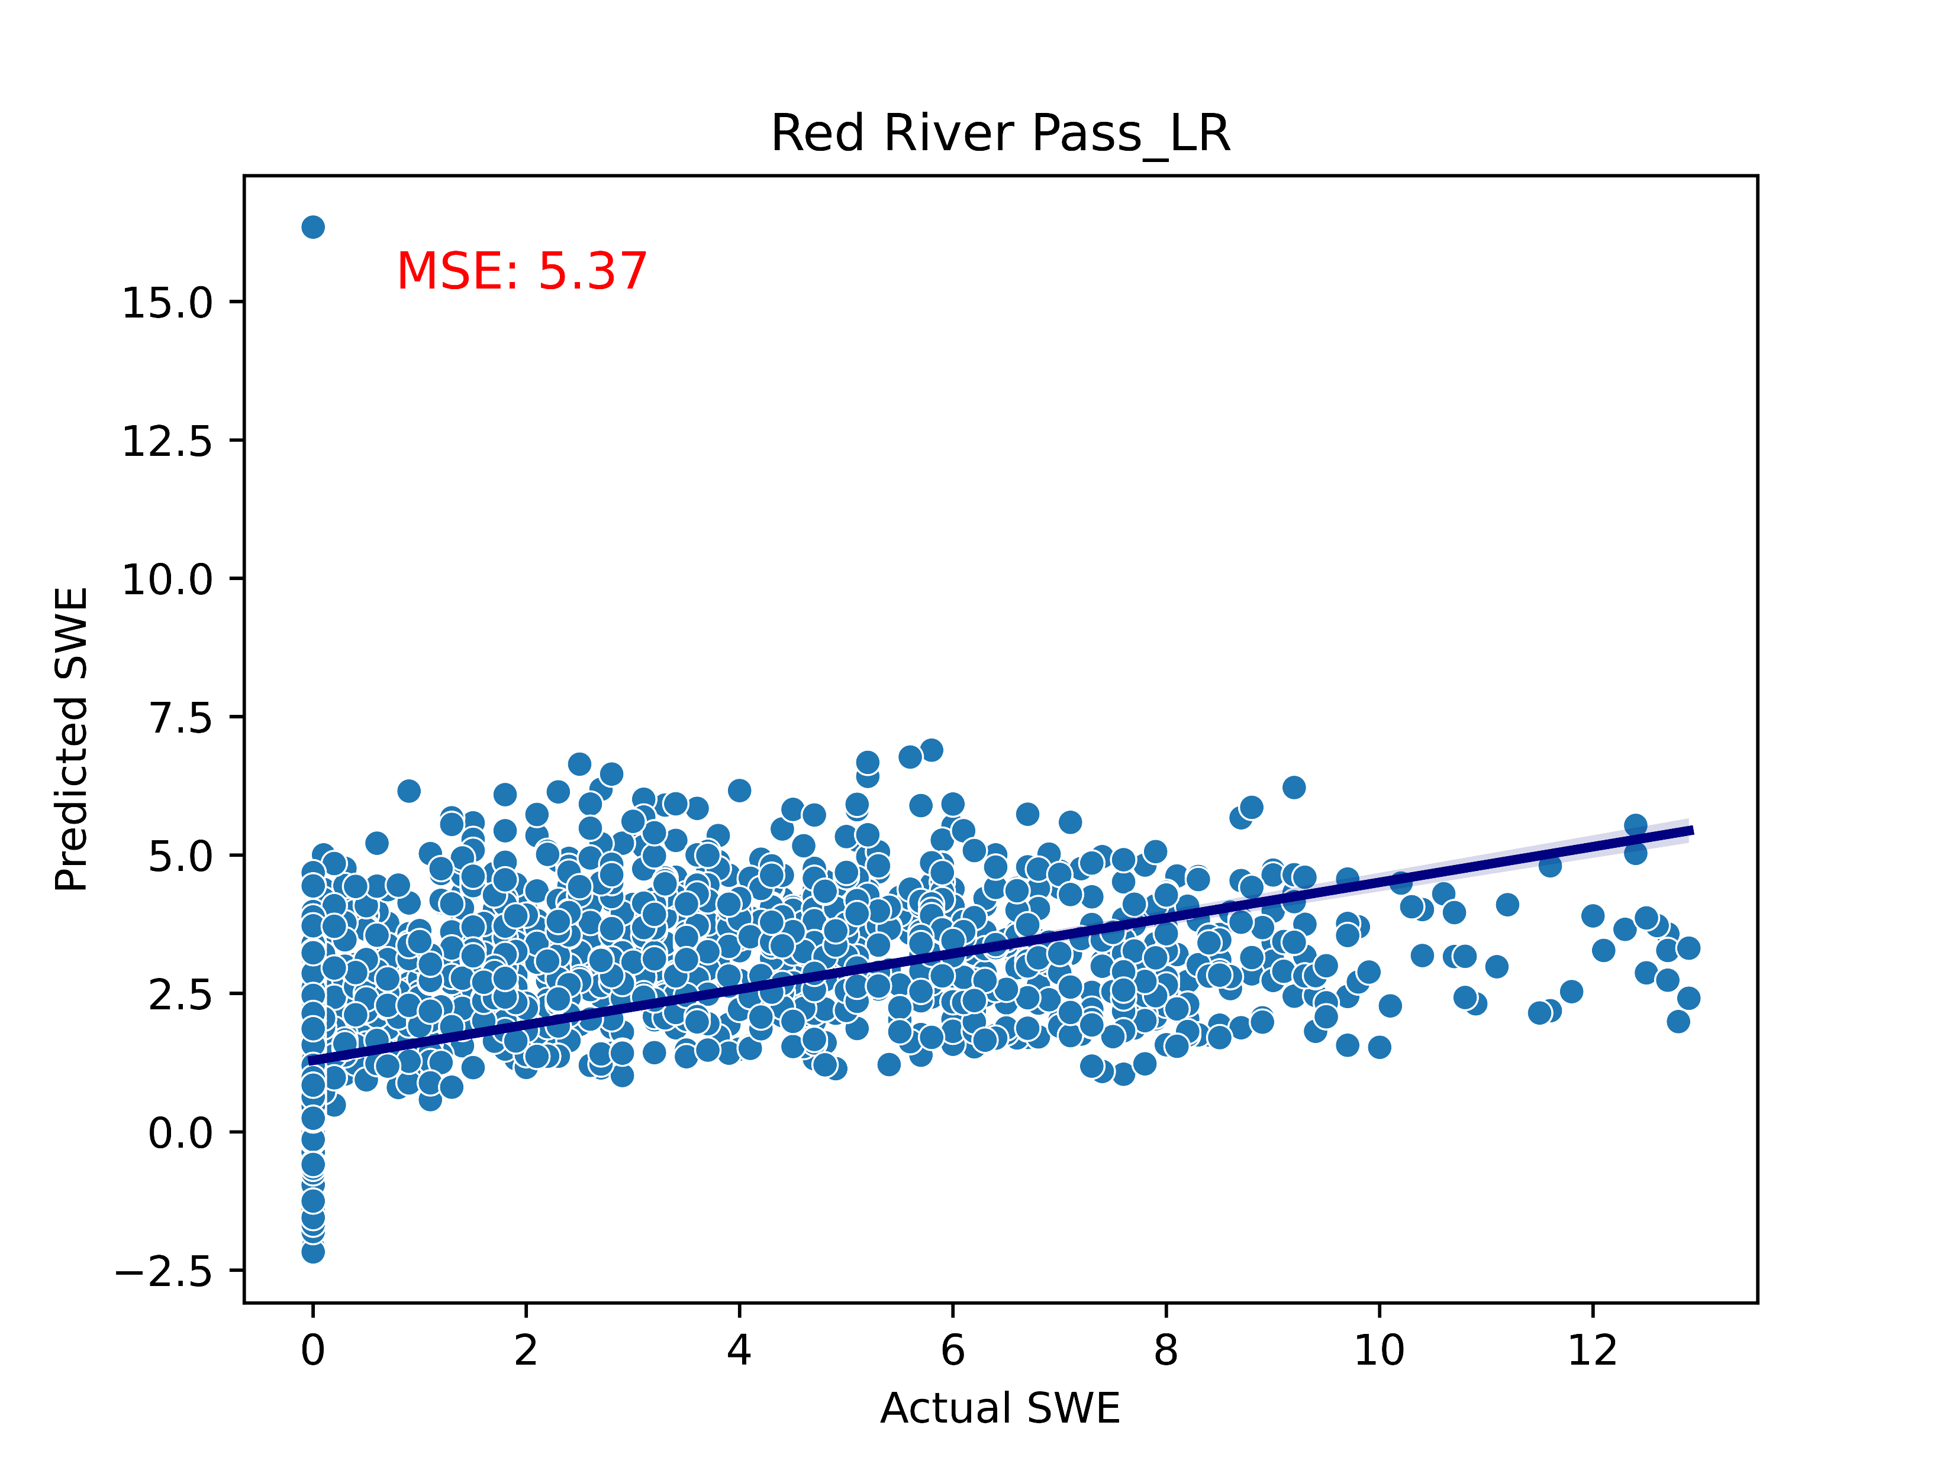
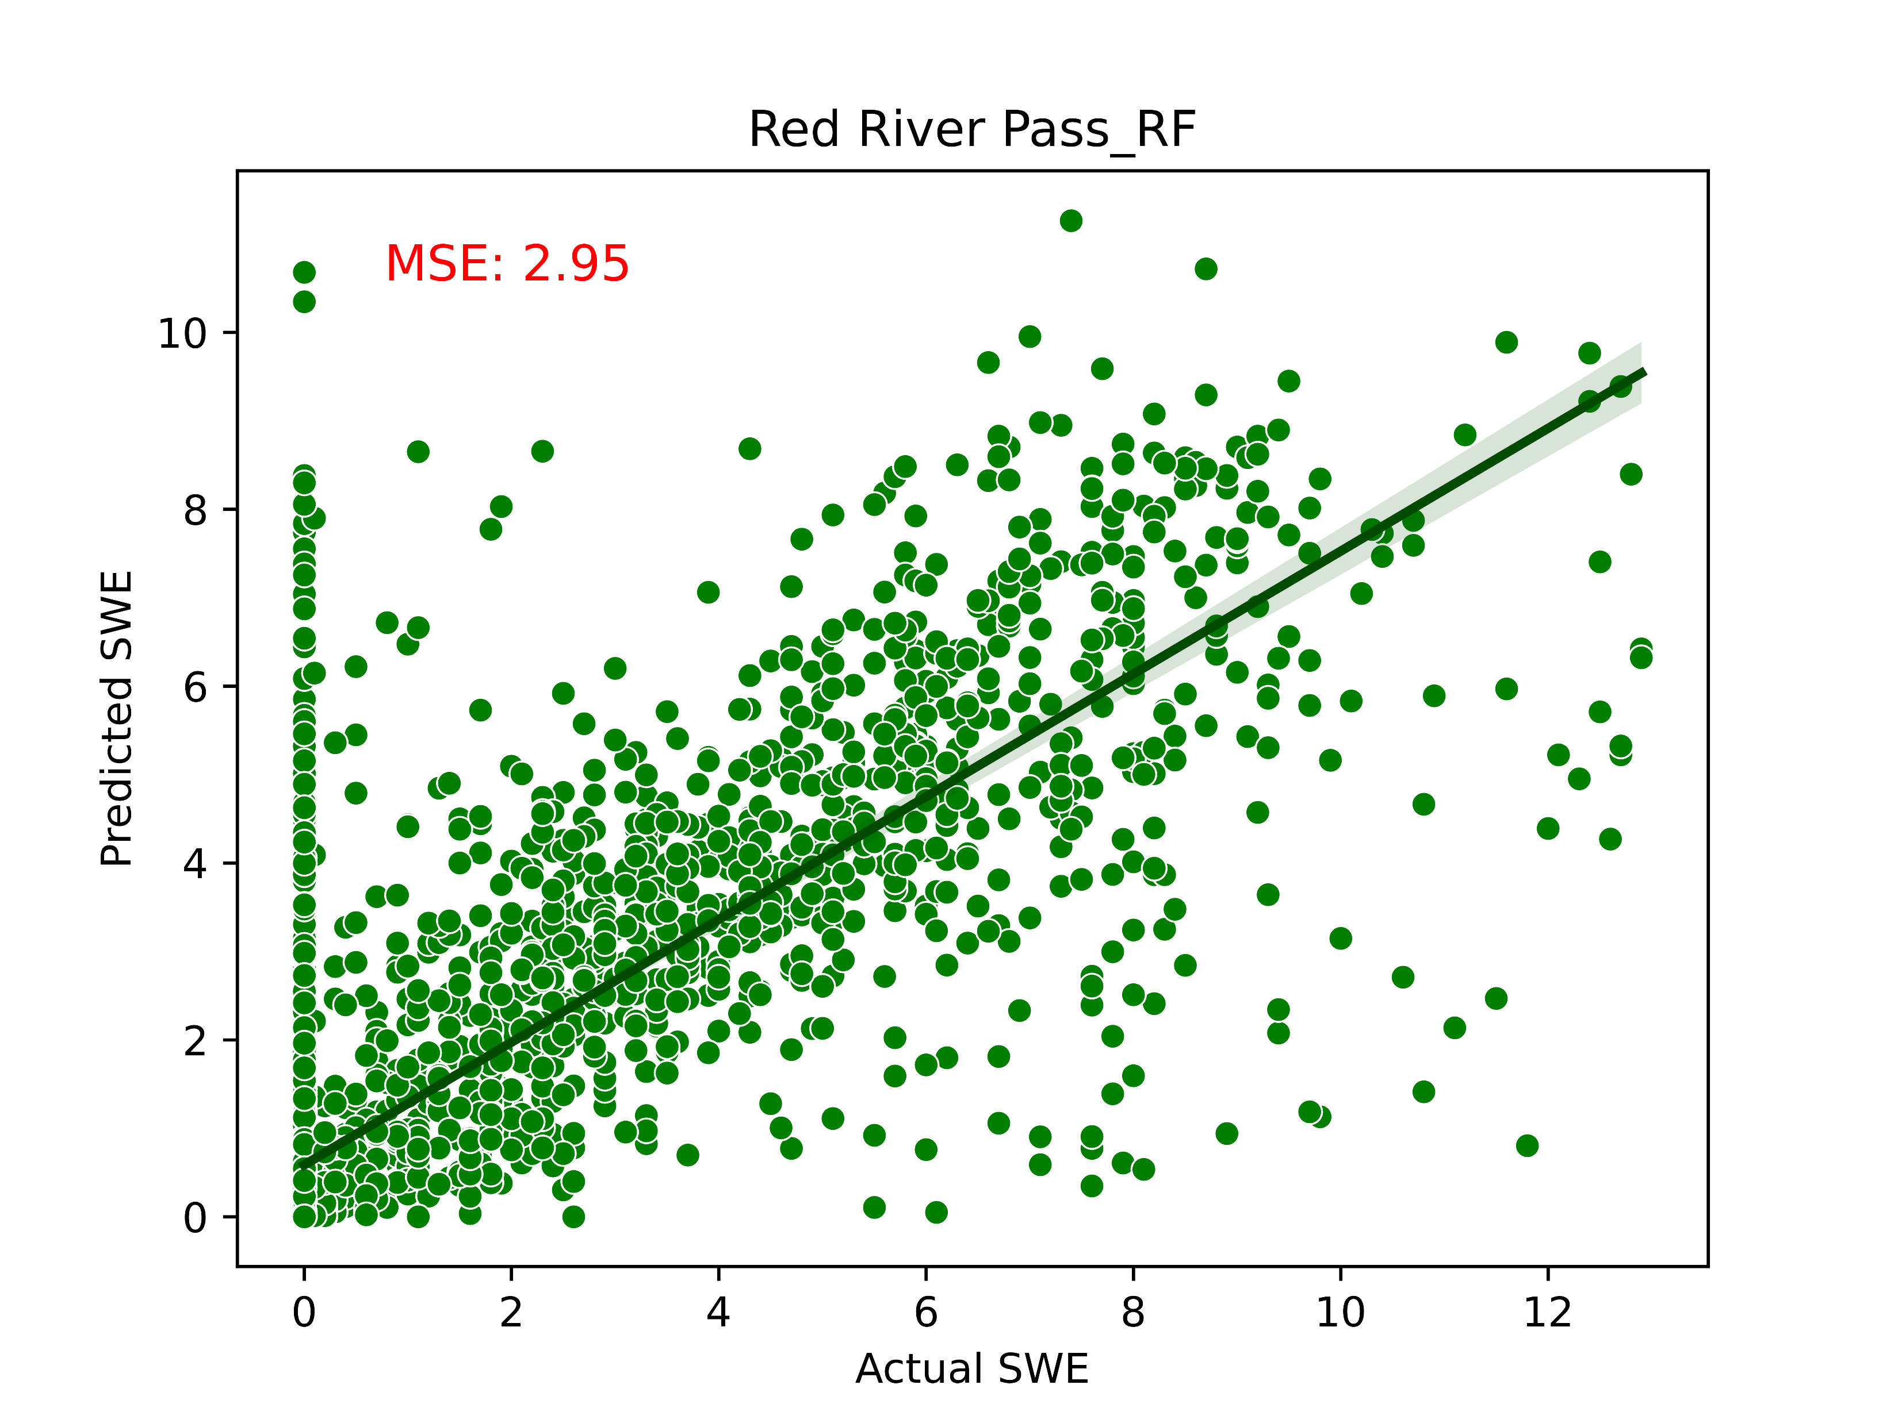
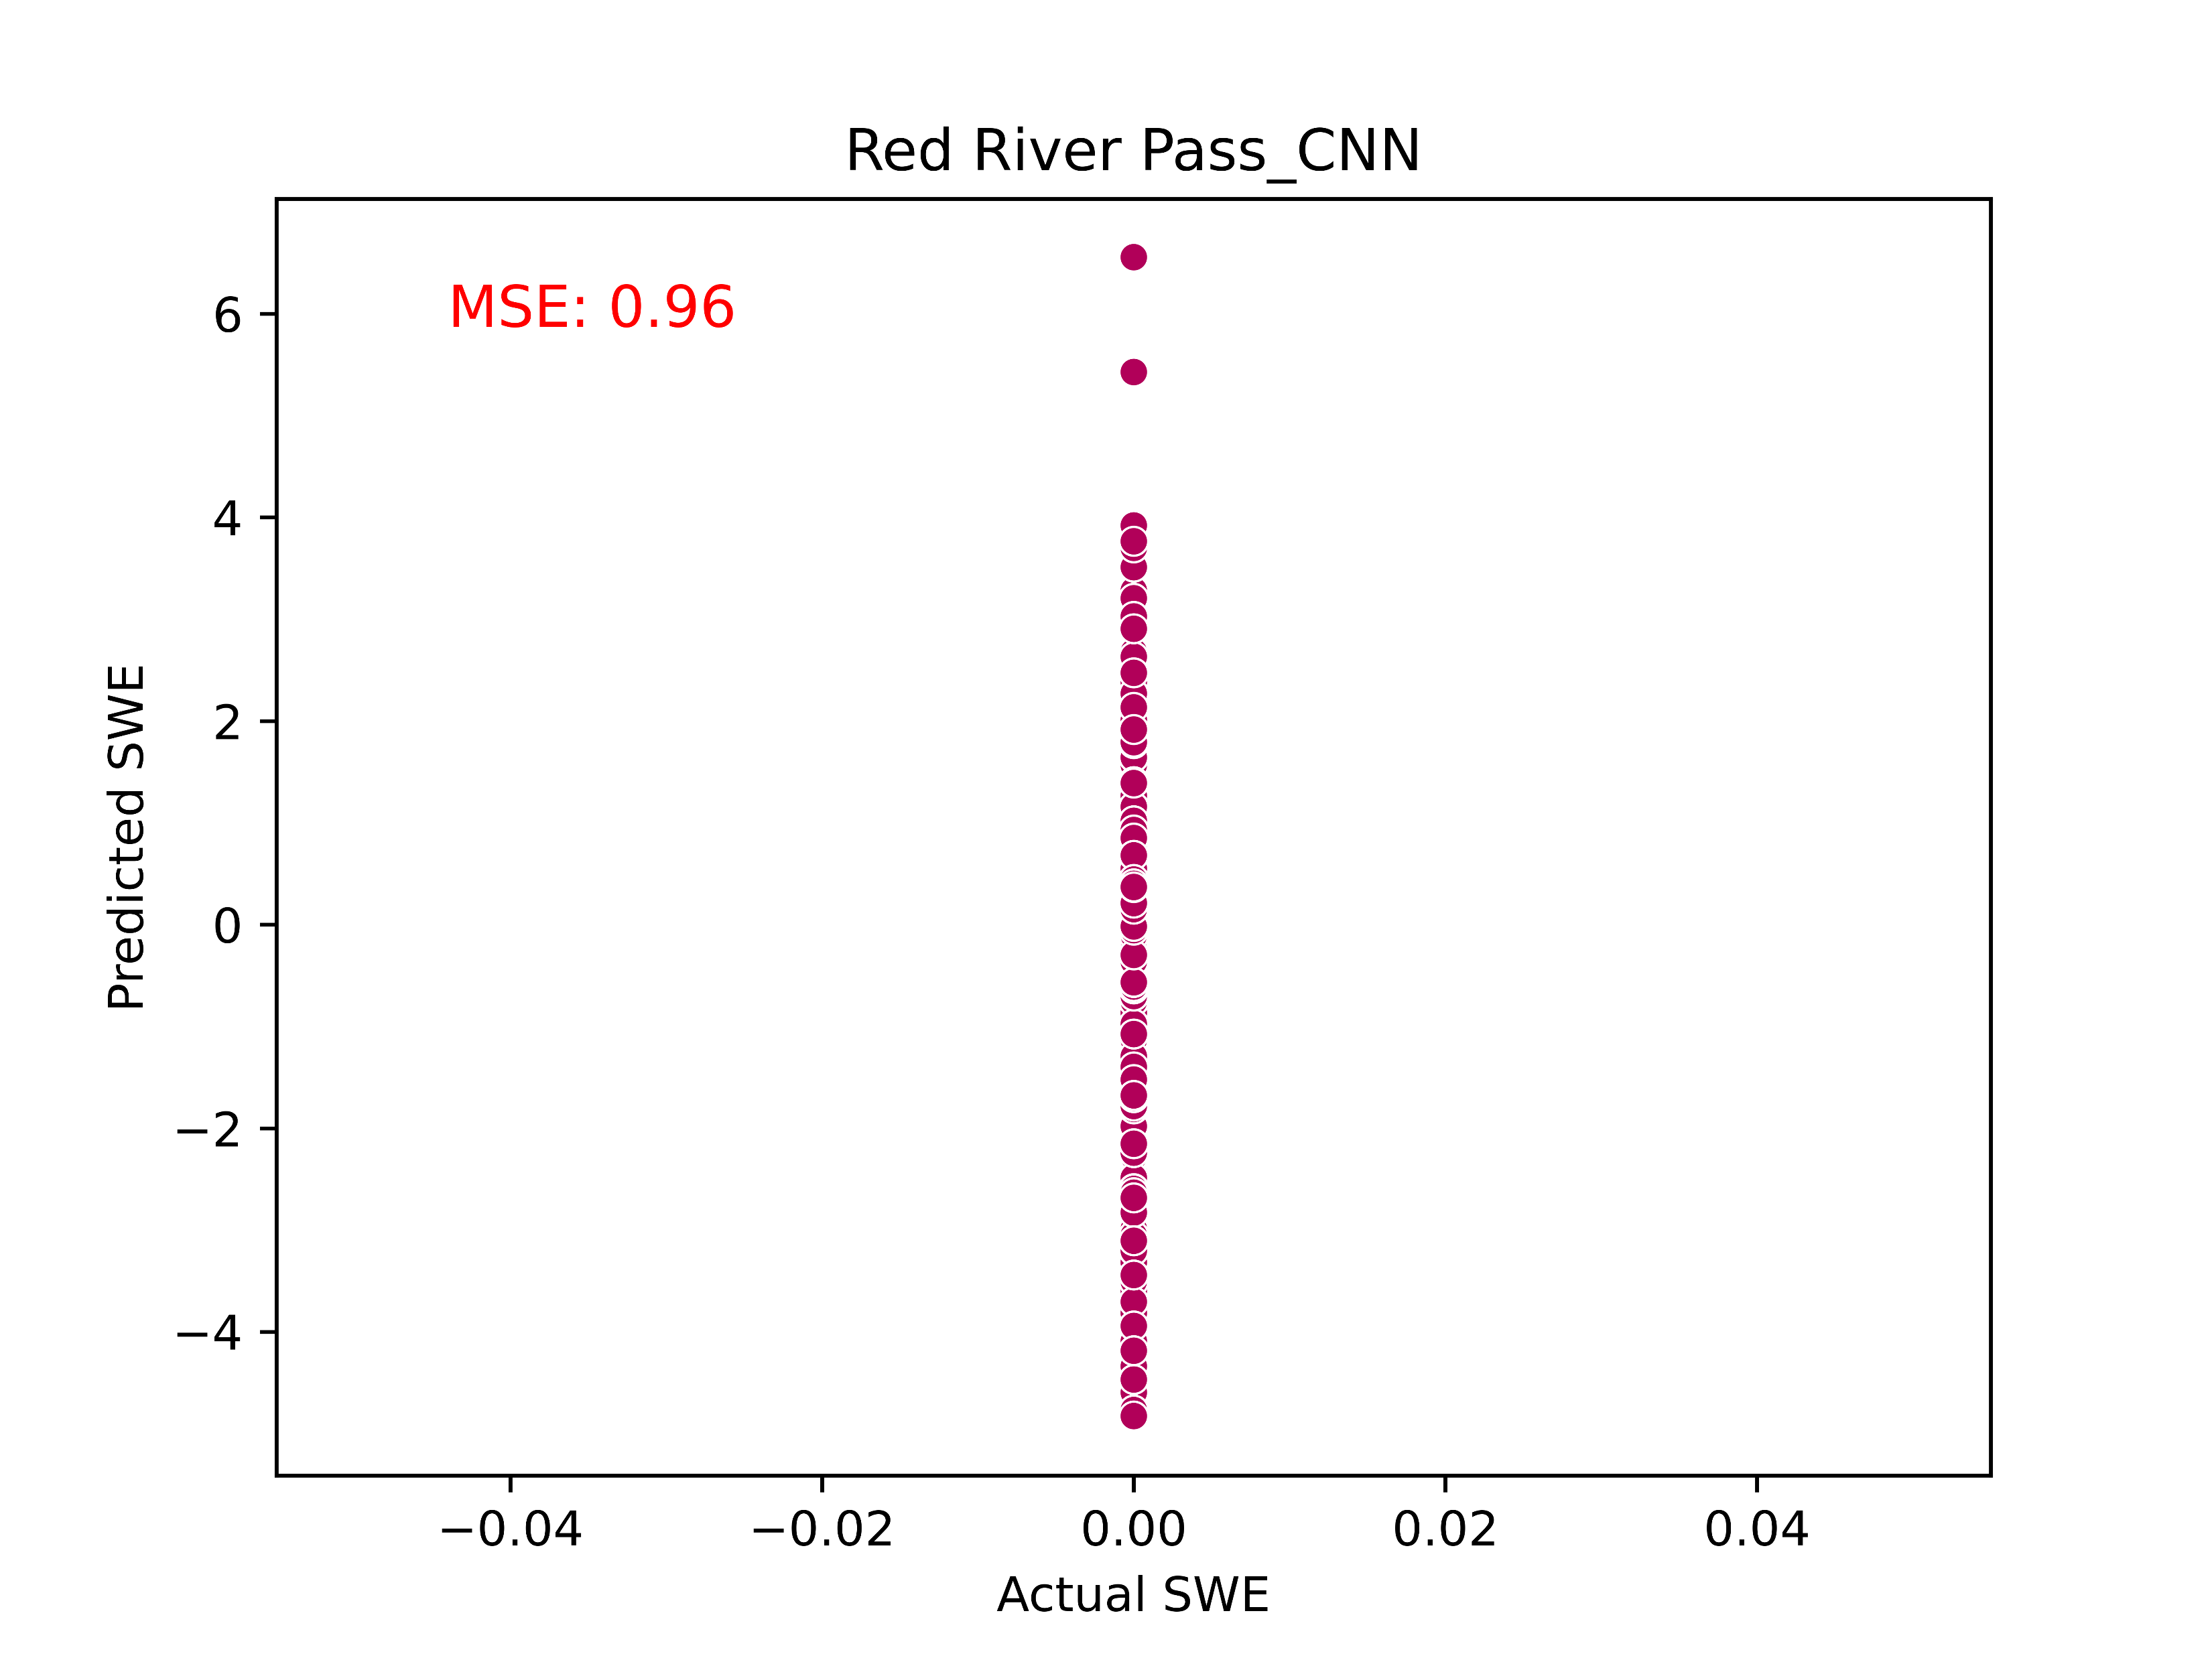
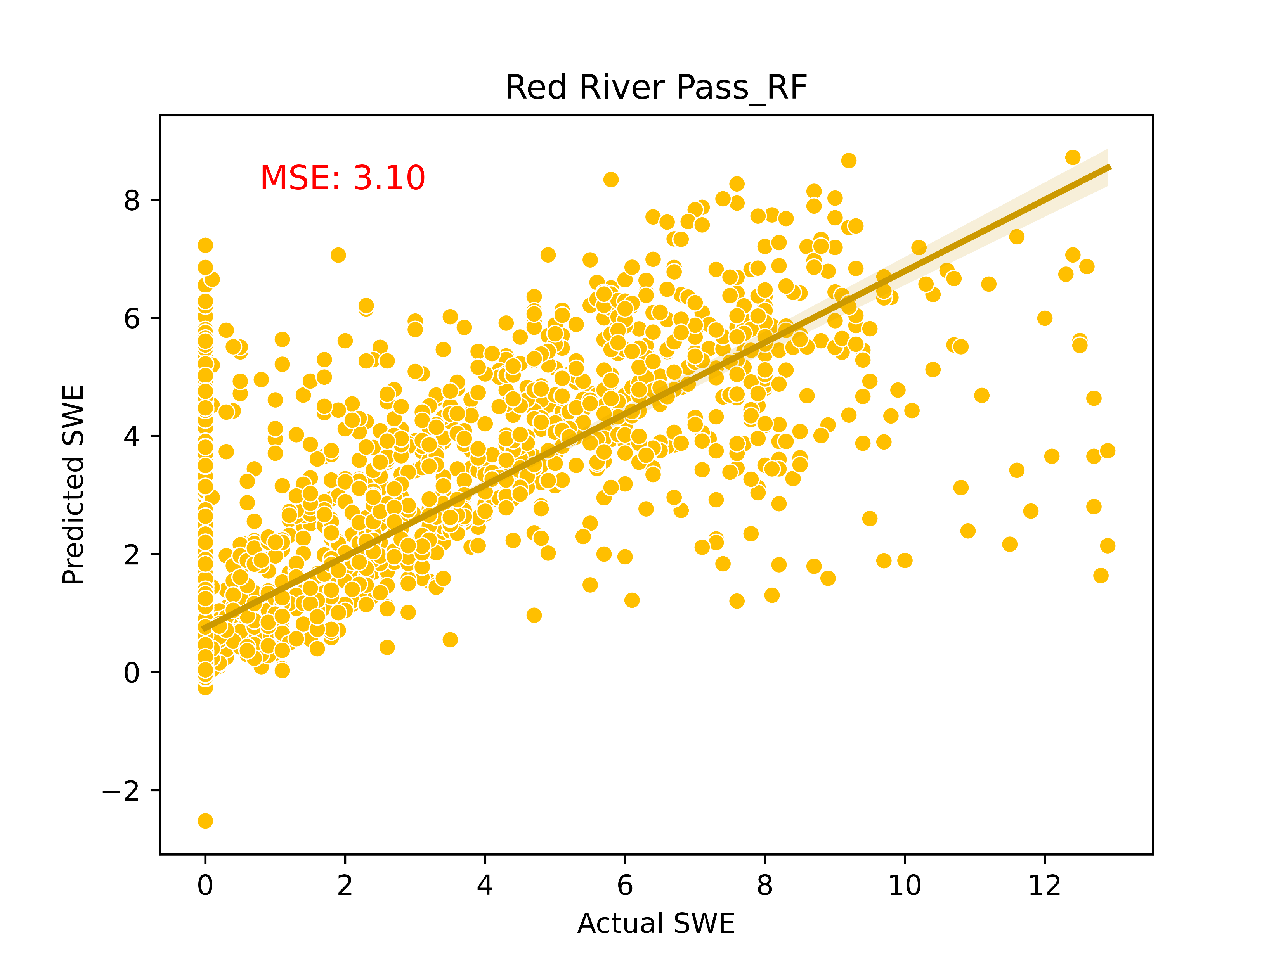

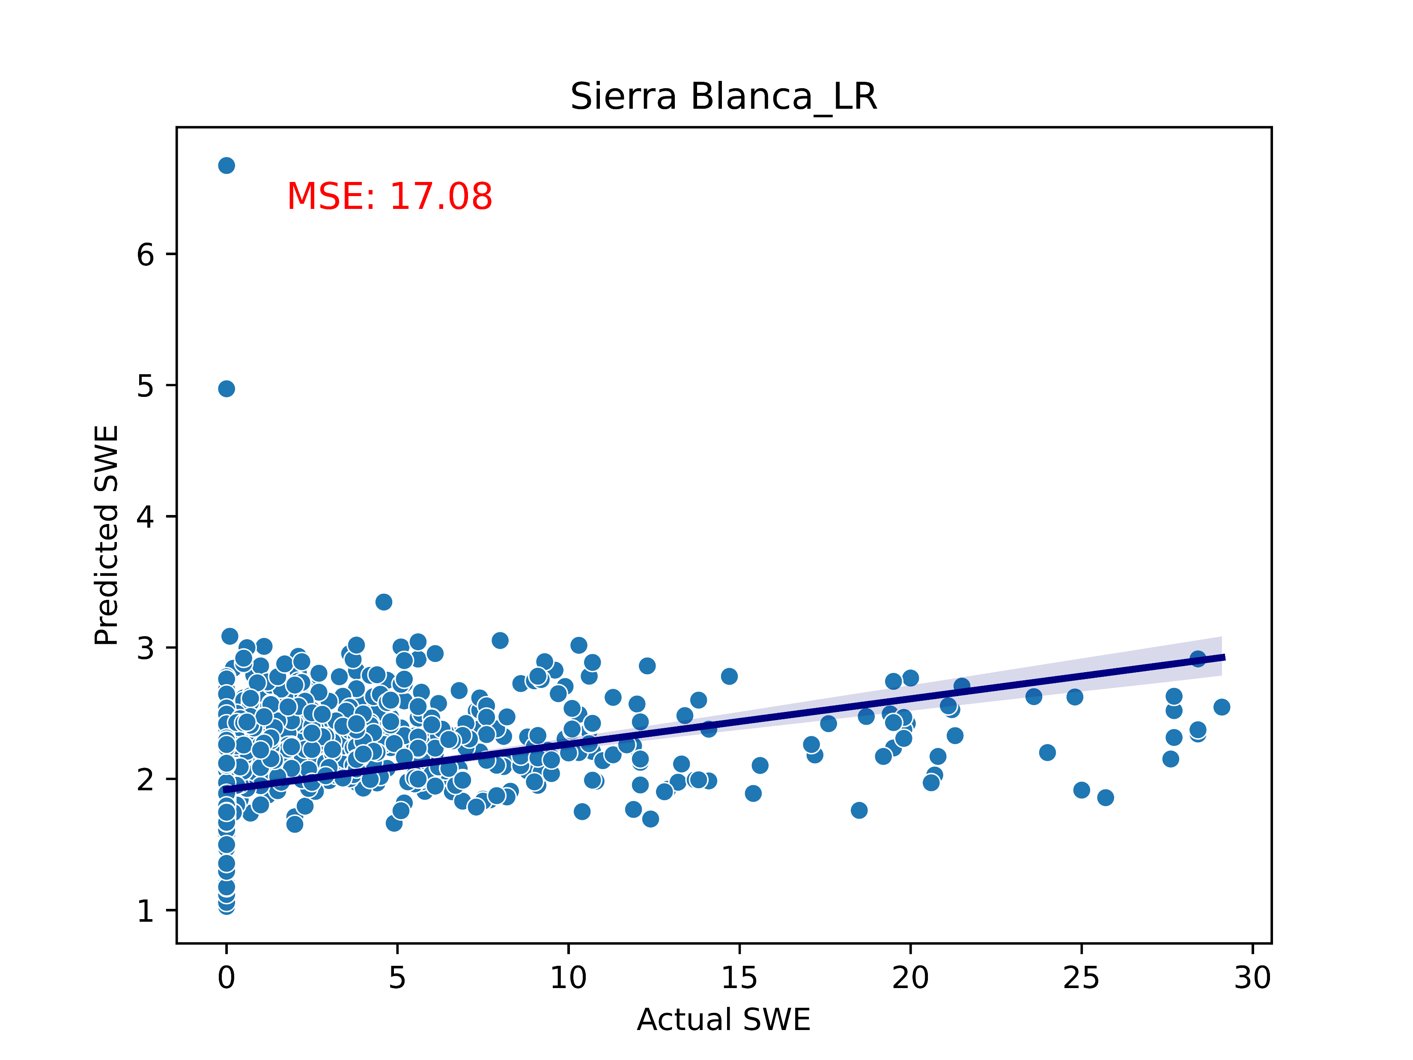
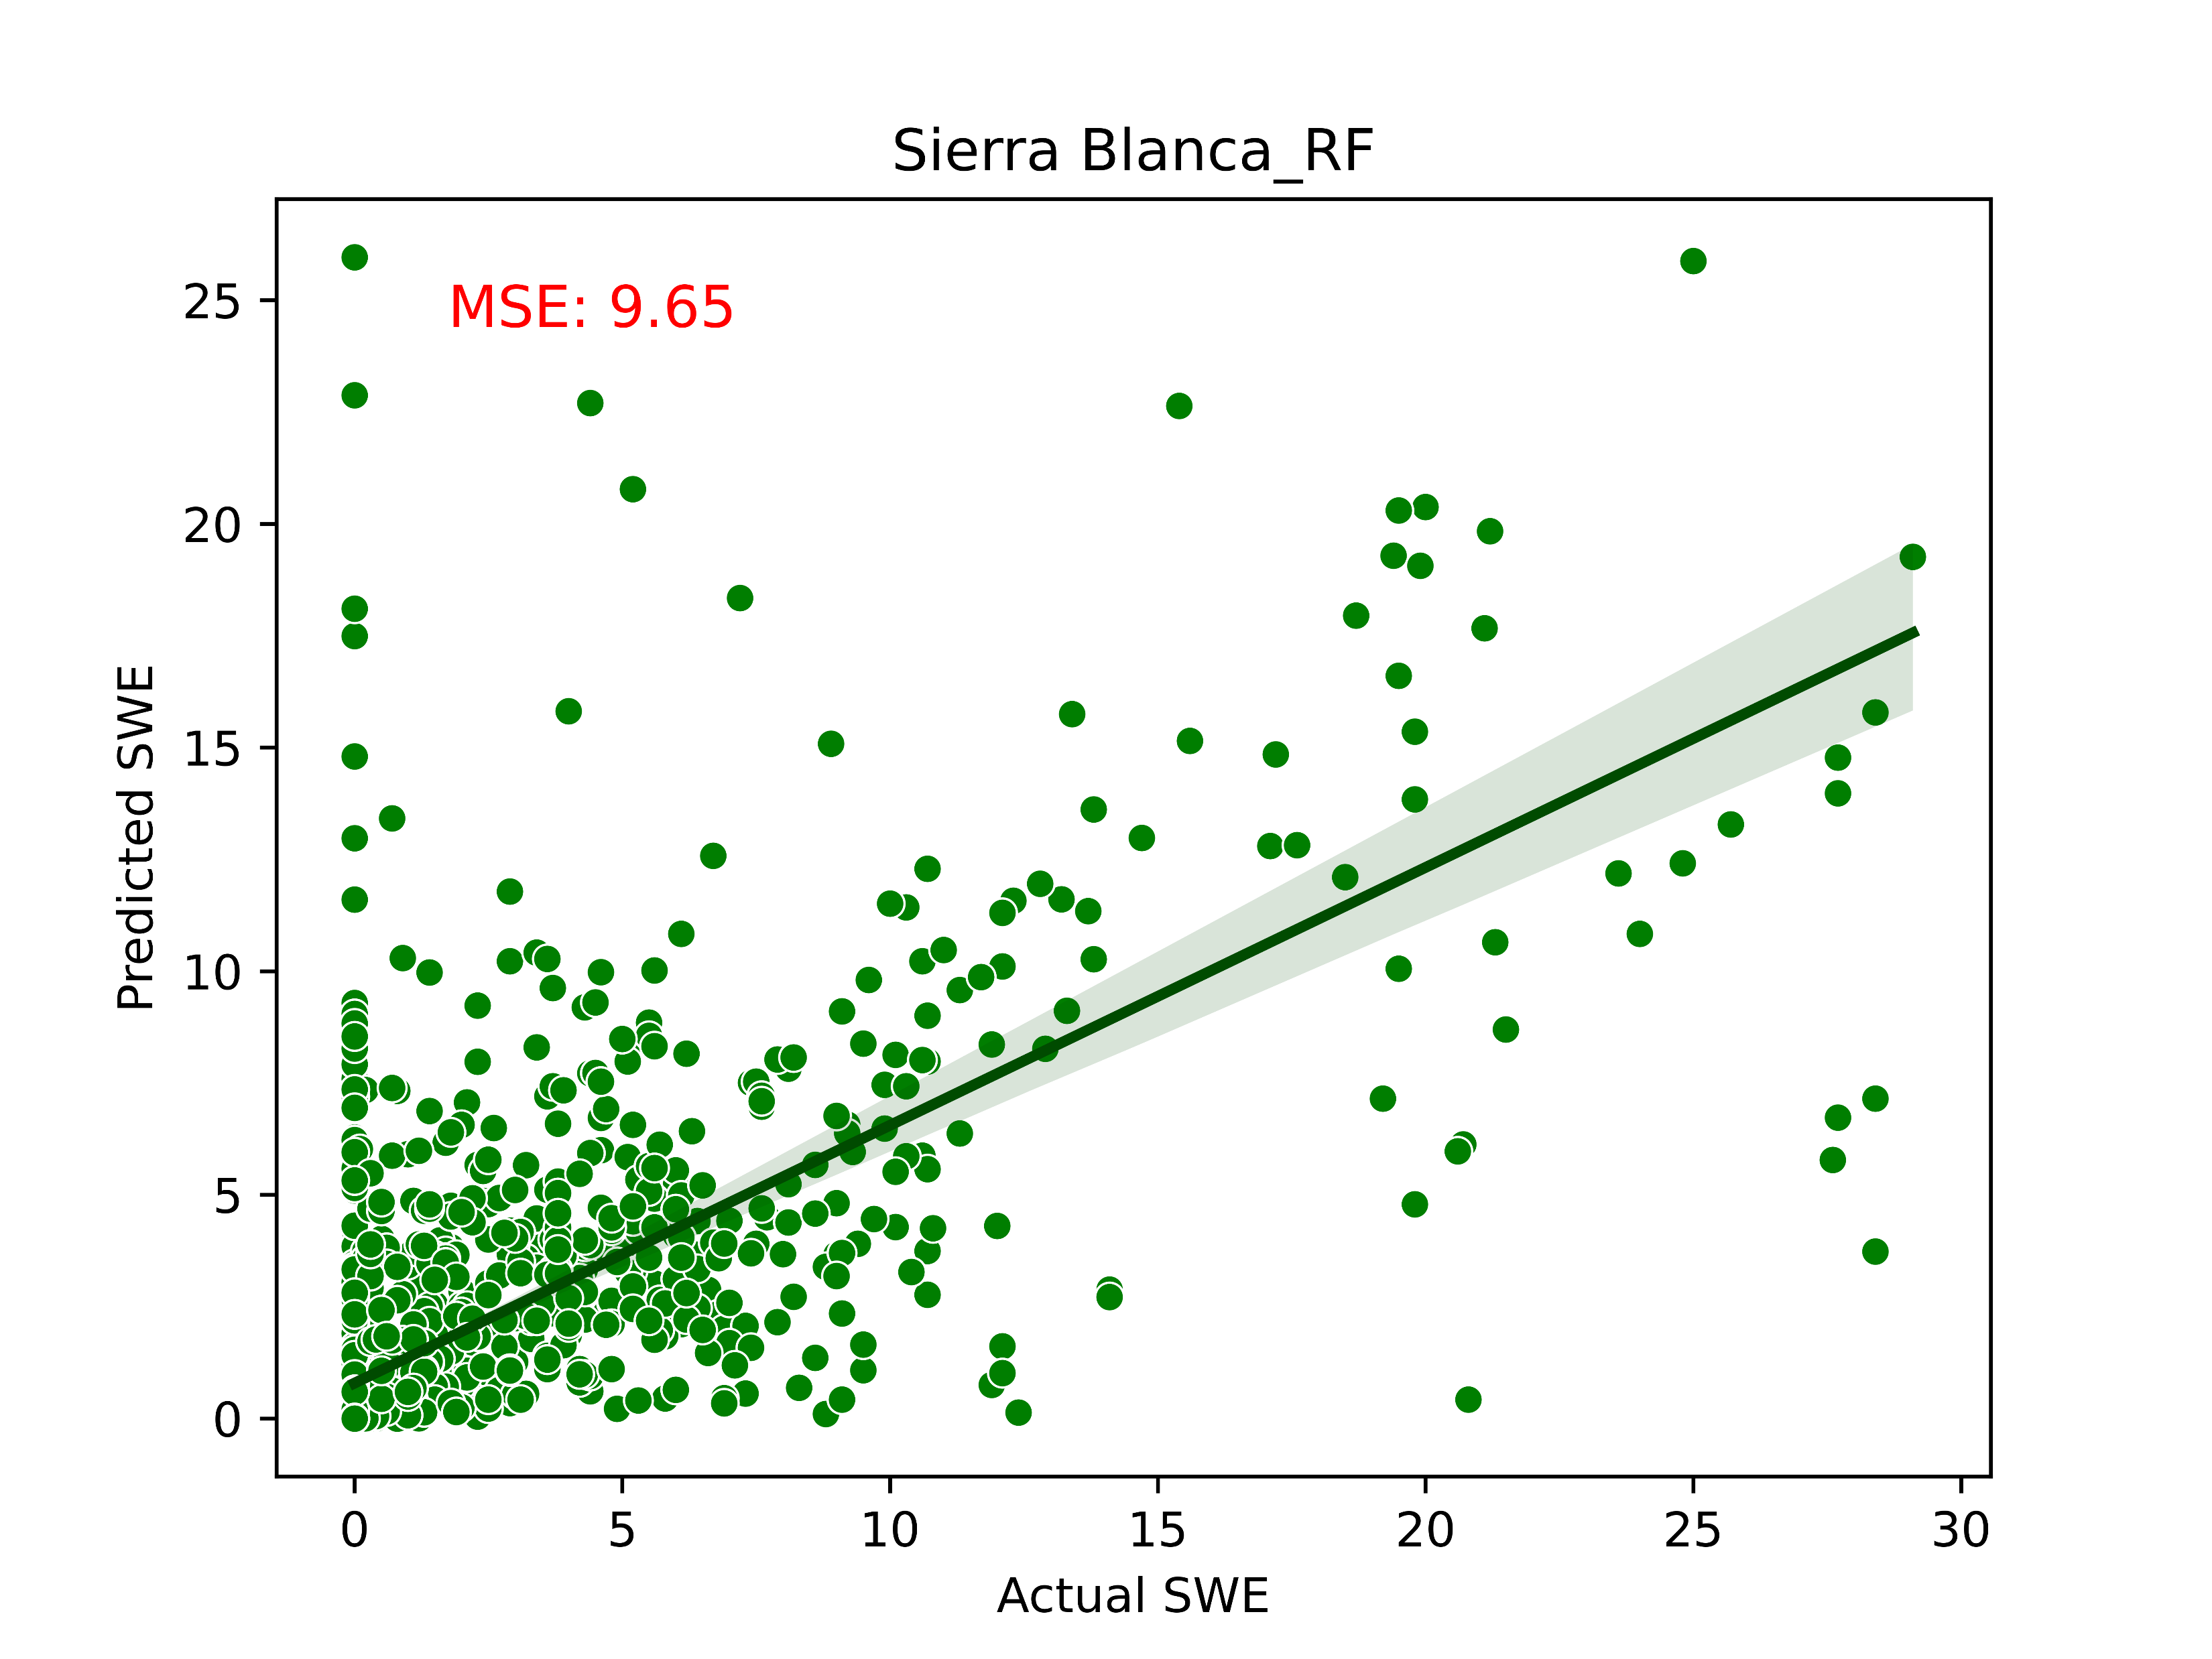
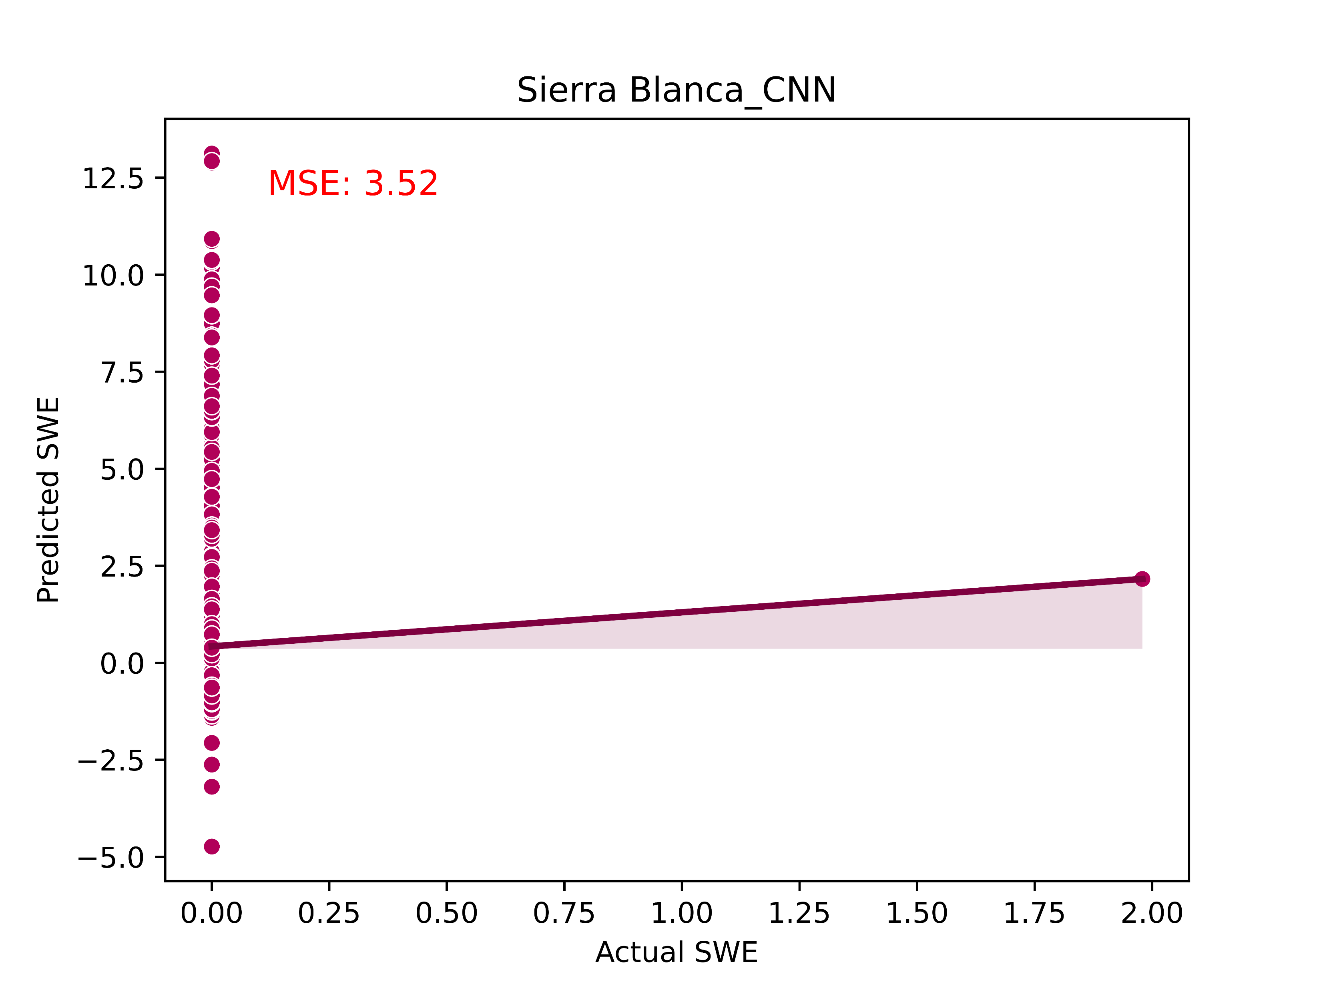
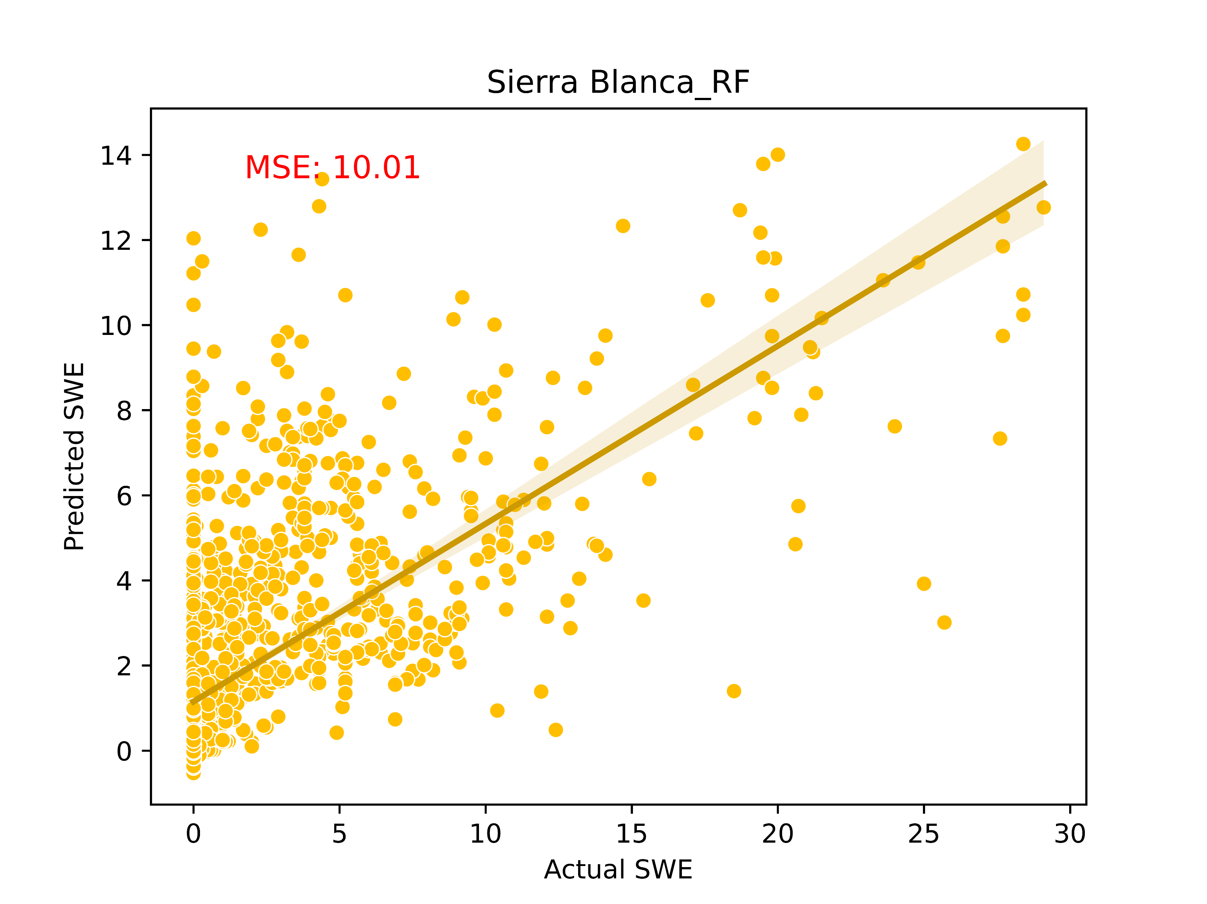
Understanding Snowpack Dynamics in the Western United States: A Machine Learning Approach
Preetika Kaurª Chakradhar Bhopalli^{b}
a-Department of Civil Engineering, b-Department of Electrical Engineering, University of Wyoming
Introduction:
Western US heavily reliant on winter snowpack.
Changing climate patterns causing decline in snowpack.
Accurate prediction of snowmelt crucial for water management.
Allocation of water among stakeholders with informed decisions.
LR
RF
CNN
LSTM
Objectives:
Explore various machine learning models:
Linear Regression (LR)
Random Forrest (RF).
Convolutional Neural Network (CNN)
Long short-term memory network (LSTM).
Data acquisition
Preprocessing
Model Testing
Model Training
Performance measure
Visualization
Study Site
Sierra Blanca
Quemazon
Garita Peak
Red River Pass
Future Work:
Figure out why CNN is acting weird
Try Feed forward neural network
Decide which model would work best and under
what circumstances?
Plot ROC and DET curves
Add more input variables such as solar radiation
Explore different terrains
Compare results with process based models and
remote sensing datasets
Notes:
It maps melt merely to temp input

